Slide 1
Network Routing Algorithms

Slide 2
Network Performance Measures
Two Performance Measures
  Quantity of Service (Throughput)
    How much data travels across the net?
    How long does it take to transfer long files?
  Quality of Service (Average packet delay)
    How long does it take for a packet to arrive at its destination?
    How responsive is the system to user commands?
    Can the network support real-time delivery such as audio and video?

Slide 3
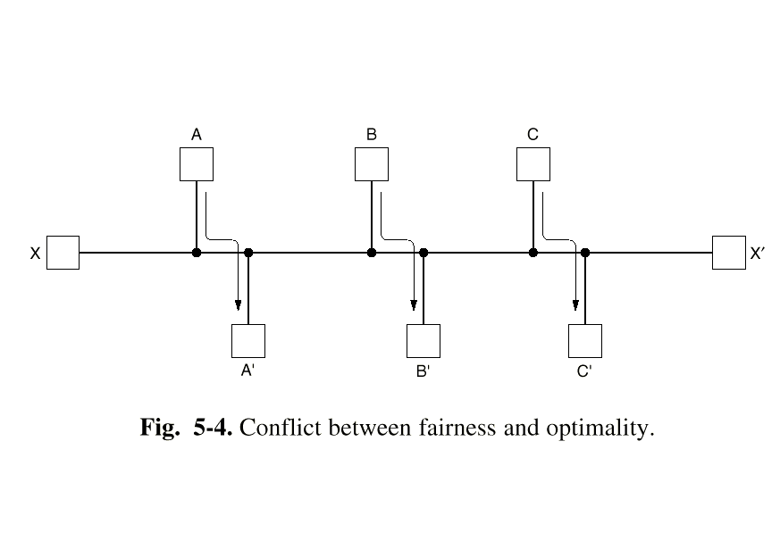
Fairness versus Optimality
Quantity of service versus quality of service.
To optimize throughput, saturate paths between A and A’, B and B’, and C and C’, but what happens to the response time from X to X’?

Slide 4
Types of Routing Algorithms
Static (Non-adaptive)
  Do not use measurements of current conditions
  Static routes are downloaded at boot time
Dynamic (Adaptive Algorithms)
  Change routes dynamically
    Gather information at runtime
      locally
      from adjacent routers
      from all other routers
    Change routes
      Every delta T seconds
      When load changes
      When topology changes

Slide 5
Optimality principle
If router j is on the optimal path from i to k, then the optimal path from j to k also falls along the same route.
(j)
k
i
(j)
(j)

Slide 6
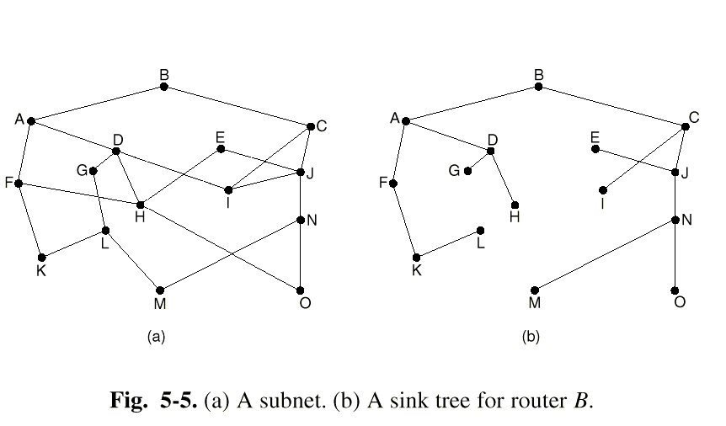
Sink Trees
The set of optimal routes to a particular node forms a sink tree.
Sink trees are not necessarily unique
Goal of all routing algorithms
  Discover sink trees for all destinations

Slide 7
Shortest Path Routing
(a non-adaptive routing algorithm)
Given a network topology and a set of weights describing the cost to send data across each link in the network
Find the shortest path from a specified source to all other destinations in the network.
Shortest path algorithm first developed by E. W. Dijkstra

Slide 8
Shortest Path Routing
(a nonadaptive routing algorithm)
Mark the source node as permanent.
Designate the source node as the working node.
Set the tentative distance to all other nodes to infinity.
While some nodes are not marked permanent
Compute the tentative distance from the source to all nodes adjacent to the working node. If this is shorter than the current tentative distance replace the tentative distance of the destination and record the label of the working node there.
Examine ALL tentatively labeled nodes in the graph. Select the node with the smallest value and make it the new working node. Designate the node permanent.

Slide 9
Dijkstra's Shortest Path Algorithm
Find shortest path from s to t.
2
24
3
9
s
18
14
6
6
2
30
4
19
11
15
5
5
6
20
16
7
t
44

Slide 10
Dijkstra's Shortest Path Algorithm
S = { }
PQ = { s, 2, 3, 4, 5, 6, 7, t }
∞
∞
2
24
3
0
9
s
∞
18
14
6
6
2
∞
30
∞
4
19
11
15
5
5
6
20
16
7
t
44
distance label
∞
∞

Slide 11
Dijkstra's Shortest Path Algorithm
S = { }
PQ = { s, 2, 3, 4, 5, 6, 7, t }
delmin
∞
∞
2
24
3
0
9
s
∞
18
14
6
6
2
∞
30
∞
4
19
11
15
5
5
6
20
16
7
t
44
distance label
∞
∞

Slide 12
Dijkstra's Shortest Path Algorithm
S = { s }
PQ = { 2, 3, 4, 5, 6, 7, t }
decrease key
∞
∞
9
X
2
24
3
0
9
s
∞
14
18
14
X
6
6
2
∞
30
∞
4
19
11
15
5
5
6
20
16
7
t
44
distance label
∞
15
∞
X

Slide 13
Dijkstra's Shortest Path Algorithm
S = { s }
PQ = { 2, 3, 4, 5, 6, 7, t }
delmin
∞
∞
9
X
2
24
3
0
9
s
∞
14
18
14
X
6
6
2
∞
30
∞
4
19
11
15
5
5
6
20
16
7
t
44
distance label
∞
15
∞
X

Slide 14
Dijkstra's Shortest Path Algorithm
S = { s, 2 }
PQ = { 3, 4, 5, 6, 7, t }
∞
∞
9
X
2
24
3
0
9
s
∞
14
18
14
X
6
6
2
∞
30
∞
4
19
11
15
5
5
6
20
16
7
t
44
∞
15
∞
X

Slide 15
Dijkstra's Shortest Path Algorithm
S = { s, 2 }
PQ = { 3, 4, 5, 6, 7, t }
decrease key
∞
33
∞
X
9
X
2
24
3
0
9
s
∞
14
18
14
X
6
6
2
∞
30
∞
4
19
11
15
5
5
6
20
16
7
t
44
∞
15
∞
X

Slide 16
Dijkstra's Shortest Path Algorithm
S = { s, 2 }
PQ = { 3, 4, 5, 6, 7, t }
∞
33
∞
X
9
X
2
24
3
0
9
delmin
s
∞
14
18
14
X
6
6
2
∞
30
∞
4
19
11
15
5
5
6
20
16
7
t
44
∞
15
∞
X

Slide 17
Dijkstra's Shortest Path Algorithm
S = { s, 2, 6 }
PQ = { 3, 4, 5, 7, t }
32
∞
33
∞
X
X
9
X
2
24
3
0
9
s
∞
14
18
14
X
6
6
2
44
∞
∞
4
30
X
19
11
15
5
5
6
20
16
7
t
44
∞
15
∞
X

Slide 18
Dijkstra's Shortest Path Algorithm
S = { s, 2, 6 }
PQ = { 3, 4, 5, 7, t }
32
∞
33
∞
X
X
9
X
2
24
3
0
9
s
∞
14
18
14
X
6
6
2
44
∞
∞
4
30
X
19
11
15
5
5
6
20
16
7
t
44
∞
15
delmin
∞
X

Slide 19
Dijkstra's Shortest Path Algorithm
S = { s, 2, 6, 7 }
PQ = { 3, 4, 5, t }
32
∞
33
∞
X
X
9
X
2
24
3
0
9
s
∞
14
18
14
X
6
6
2
44
35
∞
X
∞
4
30
X
19
11
15
5
5
6
20
16
7
t
44
59
∞
∞
15
X
X

Slide 20
Dijkstra's Shortest Path Algorithm
S = { s, 2, 6, 7 }
PQ = { 3, 4, 5, t }
delmin
32
∞
33
∞
X
X
9
X
2
24
3
0
9
s
∞
14
18
14
X
6
6
2
44
35
∞
X
∞
4
30
X
19
11
15
5
5
6
20
16
7
t
44
59
∞
∞
15
X
X

Slide 21
Dijkstra's Shortest Path Algorithm
S = { s, 2, 3, 6, 7 }
PQ = { 4, 5, t }
32
∞
33
∞
X
X
9
X
2
24
3
0
9
s
∞
14
18
14
X
6
6
2
44
35
34
∞
X
X
∞
4
30
X
19
11
15
5
5
6
20
16
7
t
44
51
59
∞
∞
15
X
X
X

Slide 22
Dijkstra's Shortest Path Algorithm
S = { s, 2, 3, 6, 7 }
PQ = { 4, 5, t }
32
∞
33
∞
X
X
9
X
2
24
3
0
9
s
∞
14
18
14
X
6
6
2
44
35
34
∞
X
X
∞
4
30
X
19
11
15
5
5
6
20
delmin
16
7
t
44
51
59
∞
∞
15
X
X
X

Slide 23
Dijkstra's Shortest Path Algorithm
S = { s, 2, 3, 5, 6, 7 }
PQ = { 4, t }
32
∞
33
∞
X
X
9
X
2
24
3
0
9
s
∞
14
18
14
X
6
6
2
35
34
45
∞
44
X
X
X
∞
4
30
X
19
11
15
5
5
6
20
16
7
t
44
50
51
59
∞
∞
15
X
X
X
X

Slide 24
Dijkstra's Shortest Path Algorithm
S = { s, 2, 3, 5, 6, 7 }
PQ = { 4, t }
32
∞
33
∞
X
X
9
X
2
24
3
0
9
s
∞
14
18
14
X
6
6
2
35
34
45
∞
44
X
X
X
∞
4
30
X
19
11
15
5
delmin
5
6
20
16
7
t
44
50
51
59
∞
∞
15
X
X
X
X

Slide 25
Dijkstra's Shortest Path Algorithm
S = { s, 2, 3, 4, 5, 6, 7 }
PQ = { t }
32
∞
33
∞
X
X
9
X
2
24
3
0
9
s
∞
14
18
14
X
6
6
2
35
34
45
∞
44
X
X
X
∞
4
30
X
19
11
15
5
5
6
20
16
7
t
44
50
51
59
∞
∞
15
X
X
X
X

Slide 26
Dijkstra's Shortest Path Algorithm
S = { s, 2, 3, 4, 5, 6, 7 }
PQ = { t }
32
∞
33
∞
X
X
9
X
2
24
3
0
9
s
∞
14
18
14
X
6
6
2
35
34
45
∞
44
X
X
X
∞
4
30
X
19
11
15
5
5
6
20
16
7
t
44
delmin
50
51
59
∞
∞
15
X
X
X
X

Slide 27
Dijkstra's Shortest Path Algorithm
S = { s, 2, 3, 4, 5, 6, 7, t }
PQ = { }
32
∞
33
∞
X
X
9
X
2
24
3
0
9
s
∞
14
18
14
X
6
6
2
35
34
45
∞
44
X
X
X
∞
4
30
X
19
11
15
5
5
6
20
16
7
t
44
50
51
59
∞
∞
15
X
X
X
X

Slide 28
Dijkstra's Shortest Path Algorithm
S = { s, 2, 3, 4, 5, 6, 7, t }
PQ = { }
32
∞
33
∞
X
X
9
X
2
24
3
0
9
s
∞
14
18
14
X
6
6
2
35
34
45
∞
44
X
X
X
∞
4
30
X
19
11
15
5
5
6
20
16
7
t
44
50
51
59
∞
∞
15
X
X
X
X

Slide 29

Another Example

Slide 30

Another Example

Slide 31

Another Example

Slide 32

Another Example

Slide 33

Another Example

Slide 34

Another Example

Slide 35

Another Example

Slide 36

Another Example

Slide 37

Another Example

Slide 38
Flooding
(a nonadaptive routing algorithm)
Brute force routing
  Every incoming packet is sent on every outgoing line
  Always finds the shortest path quickly
  Also finds many long paths
  Time to live is set to size of subnet
Selective Flooding
  Flood only in the direction of the destination
Practical in a few settings
  Military Applications
  Distributed Databases
  Metric for comparison

Slide 39
Flooding for Data Delivery
Sender S broadcasts data packet P to all its neighbors
Each node receiving P forwards P to its neighbors
Sequence numbers used to avoid the possibility of forwarding the same packet more than once
Packet P reaches destination D provided that D is reachable from sender S
Node D does not forward the packet

Slide 40

Flooding for Data Delivery
Y
Z
S
E
F
B
C
M
L
J
A
G
H
D
K
I
N
Represents a node that has received packet P
Represents that connected nodes are within each
other’s transmission range

Slide 41
Flooding for Data Delivery
Y
Broadcast transmission
Z
S
E
F
B
C
M
L
J
A
G
H
D
K
I
N
Represents a node that receives packet P for
the first time
Represents transmission of packet P

Slide 42
Flooding for Data Delivery
Y
Z
S
E
F
B
C
M
L
J
A
G
H
D
K
I
N
Node H receives packet P from two neighbors:
potential for collision

Slide 43
Flooding for Data Delivery
Y
Z
S
E
F
B
C
M
L
J
A
G
H
D
K
I
N
Node C receives packet P from G and H, but does not forward
it again, because node C has already forwarded packet P once

Slide 44
Flooding for Data Delivery
Y
Z
S
E
F
B
C
M
L
J
A
G
H
D
K
I
N
Nodes J and K both broadcast packet P to node D
Since nodes J and K are hidden from each other, their
transmissions may collide
=> Packet P may not be delivered to node D at all,
despite the use of flooding

Slide 45
Flooding for Data Delivery
Y
Z
S
E
F
B
C
M
L
J
A
G
H
D
K
I
N
Node D does not forward packet P, because node D
is the intended destination of packet P

Slide 46
Flooding for Data Delivery
Y
Z
S
E
F
B
C
M
L
J
A
G
H
D
K
I
N
Flooding completed
Nodes unreachable from S do not receive packet P (e.g., node Z)
Nodes for which all paths from S go through the destination D
also do not receive packet P (example: node N)

Slide 47
Flooding for Data Delivery
Y
Z
S
E
F
B
C
M
L
J
A
G
H
D
K
I
N
Flooding may deliver packets to too many nodes
(in the worst case, all nodes reachable from sender
may receive the packet)

Slide 48
Flooding for Data Delivery: Advantages
Simplicity
May be more efficient than other protocols when rate of information transmission is low enough that the overhead of explicit route discovery/maintenance incurred by other protocols is relatively higher
  this scenario may occur, for instance, when nodes transmit small data packets relatively infrequently, and many topology changes occur between consecutive packet transmissions
Potentially higher reliability of data delivery
  Because packets may be delivered to the destination on multiple paths

Slide 49
Flooding for Data Delivery: Disadvantages
Potentially, very high overhead
  Data packets may be delivered to too many nodes who do not need to receive them
Potentially lower reliability of data delivery
  Flooding uses broadcasting -- hard to implement reliable broadcast delivery without significantly increasing overhead
      Broadcasting in IEEE 802.11 MAC is unreliable
  In our example, nodes J and K may transmit to node D simultaneously, resulting in loss of the packet
      in this case, destination would not receive the packet at all

Slide 50
Flooding of Control Packets
Many protocols perform (potentially limited) flooding of control packets, instead of data packets
The control packets are used to discover routes
Discovered routes are subsequently used to send data packet(s)
Overhead of control packet flooding is amortized over data packets transmitted between consecutive control packet floods

Slide 51
Flow-based Routing
(a nonadaptive routing algorithm)
B
H
D
E
A
G
C
F
ACFED may be faster than ABD if AB and/or BD are heavily loaded.
Flow-based routing uses network topology, traffic matrices, and capacity matrices to determine static routes.

Slide 52
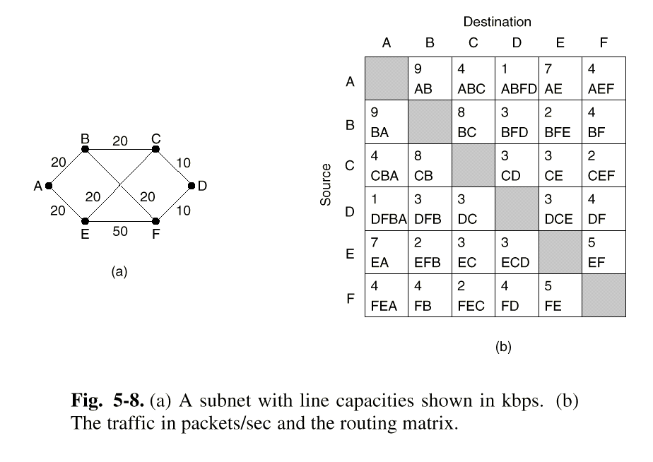
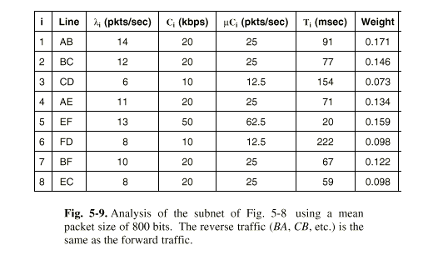
Analyzing Network Flow
(Optimize for mean delay)
Mean delay is T_{i} = 1/(uC_{i} - lambda_{i})
where 1/u is mean packet size in bits
C_{i} is capacity in bps
lambda_{i} = mean flow in packets/sec
Weight is the percent of packet
traffic that traverses this path.
Mean delay is weighted average of T.
Recalculate mean delay for all possible routes.

Slide 53
The Split Horizon Hack
Actual distance to a destination is not reported on the line on which packets to that destination are sent.
Instead these distances are reported as “infinity.”
A
B
C
C tells D the truth
about its distance to
A, but lies to B and
says the distance is
infinity.
D

Slide 54
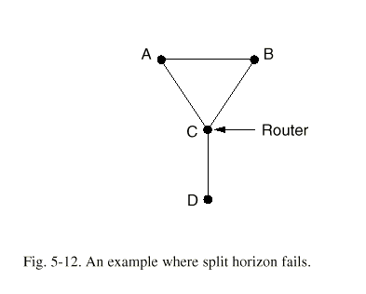
A topology where split horizon fails
Suppose that D becomes
unreachable from C.
A and B are reporting
infinite distances to C, but
they are reporting distances
of length 2 to each other.
A and B will count to infinity.

Slide 55
Link State Routing
(an adaptive routing algorithm)
Five Steps
1.) Discover your neighbors and learn their addresses.
2.) Measure the cost (delay) to each neighbor.
3.) Construct a link packet containing all this information
4.) Send this packet to all other routers.
5.) Compute the shortest path to every other router.

Slide 56
1.) Discovering Your Neighbors
Send “Hello” packet on each point-to-point line. Destination node replies with its address.

Slide 57
2.) Measuring Line Cost
Send an “ECHO” packet over the line.
Destination is required to respond to “ECHO” packet immediately.
Measure the time required for this operation.
Question: Should we measure just the time it takes to transmit the packet, or should we include the time that the packet waits in the queue?

Slide 58
Argument 2:
We should include the time that the packet spends in the queue, as this provides a more accurate picture of the real delays.
We should only include the transmission times, otherwise the network is likely to oscillate between preferred paths.

Slide 59
Oscillating Paths
A
The cost of routing
clockwise is the
number of other
nodes routing
clockwise.
Consider the situation
where all nodes are
sending to destination
A.
L
B
K
C
J
D
Each node must
determine to either
route clockwise
or counter clockwise.
I
E
H
F
G

Slide 60
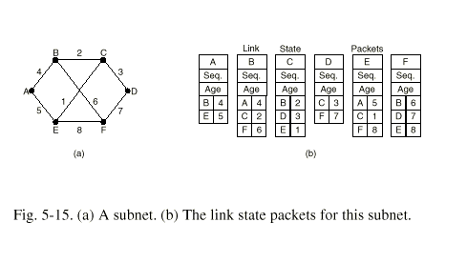
Build Link State Packets
Decremented by each router by 1 to decrease its life. Its value also decreases by 1 every second to lower its life in the network
Used by the routers to decide which packet to forward and which to block

Slide 61
Distributing the Link State Packets
Use selective flooding
Sequence numbers prevent duplicate packets from being propagated
Lower sequence numbers are rejected as obsolete

Slide 62
Computing the New Routes
Dijkstra’s Shortest Path algorithm is used to determine the shortest path to each destination.

Slide 63
Distance Vector Routing
(an adaptive routing algorithm)
Bellman-Ford Routing
Ford Fulkerson Algorithm
Original ARPANET routing algorithm
Previously used on Internet (RIP)
Early version of DecNet and Novell’s IPX
AppleTalk and Cisco routers use improved versions of this algorithm

Slide 64
Distance Vector Routing
(an adaptive routing algorithm)
Neighboring routers periodically exchange information from their routing tables.
Routers replace routes in their own routing tables anytime that neighbors have found better routes.
Information provided from neighbors
  Outgoing line used for destination
  Estimate of time or distance
    can be number of hops, time delay, packet queue length, etc.

Slide 65
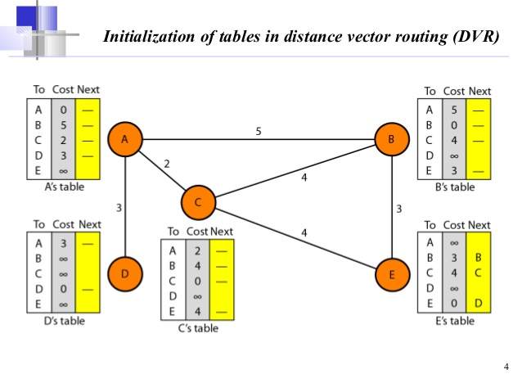


Slide 66
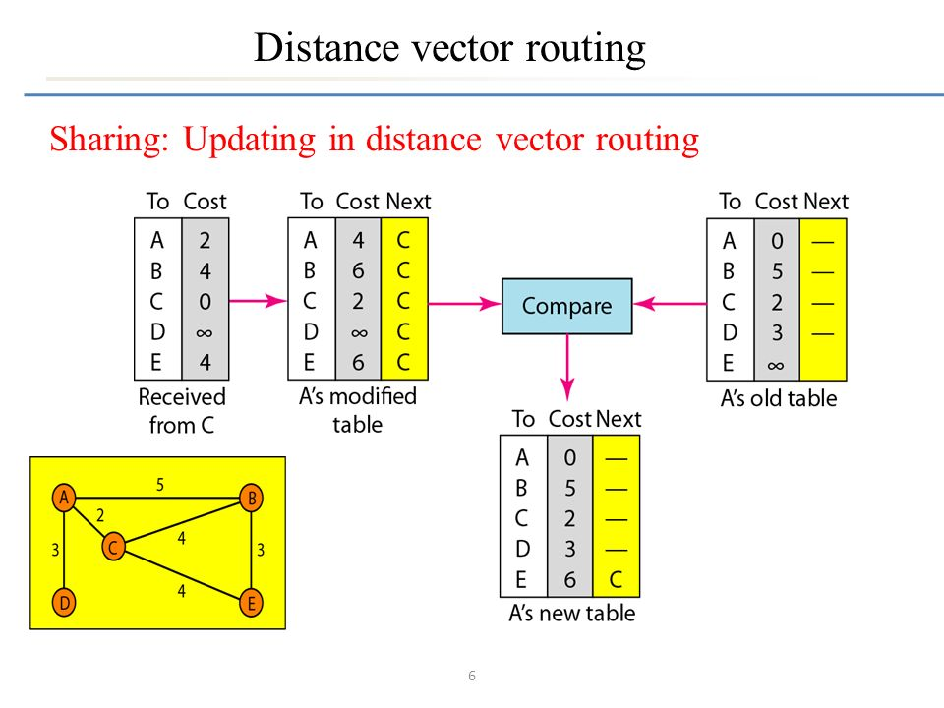

Slide 67
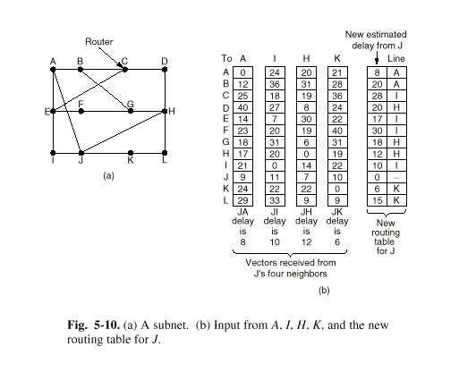
Distance Vector Routing
(an adaptive routing algorithm)

Slide 68
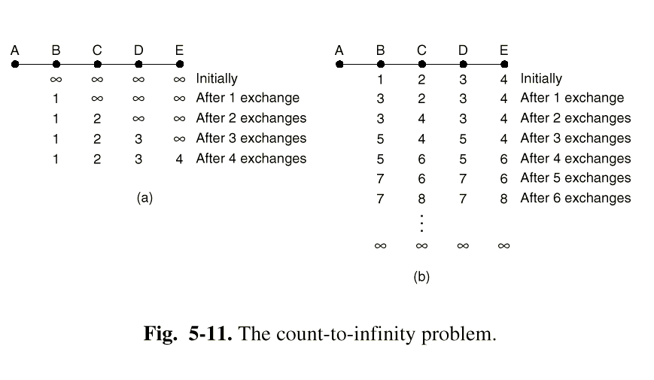
The Count to Infinity Problem

Slide 69
Hierarchical Routing
Addresses the growth of routing tables
Routers are divided into regions
Routers know the routes for their own regions only
Works like telephone routing
Possible hierarchy
  city, state, country, continent
Optimal number of levels for an N router subnet is lnN

Slide 70
Routing Mobile Hosts
Networking portable computers
Tanenbaum’s proposed solution
  All mobile agents are assumed to have a permanent home location
  When a portable computer is attached to a remote network it contacts a process that acts as the local foreign agent.
  Each home location has a process that acts as the home agent

Slide 71
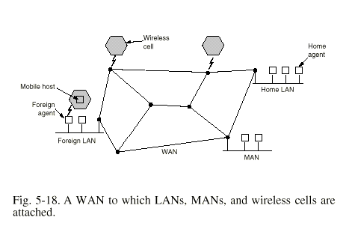
The Agents on the Network

Slide 72
Registering a Mobile Agent
Periodically the foreign agent broadcasts its address
The mobile agent registers with the foreign agent and supplies its home address
The foreign agent contacts the mobile agent’s home agent reporting the mobile agent’s location.
  Security must be used to verify the identity of the mobile agent.
The foreign agent registers the mobile agent

Slide 73
Routing Packets to a Mobile Agent
Packets sent to the mobile agent are routed to the users home network
The home agent routes the packets to the foreign agent
The home agent provides the source of incoming packets with the remote address of the mobile agent

Slide 74
Broadcast Routing
Send a separate packet to each destination
Use flooding
Use multidestination routing
  Each packet contains a list of destinations
  Routers duplicate packet for all matching outgoing lines
Use spanning tree routing
  a subset of the subnet that includes all routers but contains no loops.

Slide 75
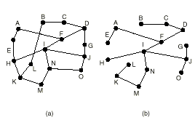
Spanning Tree Broadcasting
Uses the minimum number of packets necessary
Routers must be able to compute spanning tree
  Available with link state routing
  Not available with distance vector routing

Slide 76
Broadcast Routing (continued)
Reverse Path Forwarding
  Use When knowledge of a spanning tree is not available
  Provides an approximation of spanning tree routing
  Routers check to see if incoming packet arrives from the same line that the router uses to route outgoing packets to the broadcast source
    If so, the router duplicates the packet on all other outgoing lines
    Otherwise, the router discards the packet

Slide 77
Reverse Path Forwarding Example
This router routes
packets bound for
128.173.41.41 to
via line A.
A
B
Any broadcast from
128.173.41.41 that
arrives from line A
is broadcast on lines
B, C, D, and E
C
Any broadcast from
128.173.41.41 that
arrives from line B,
C, D, or E is discarded
D
E

Slide 78
Multicast Routing
A method to broadcast packets to well-defined groups
Hosts can join multicast groups.
  They inform their routers
  Routers send group information throughout the subnet
Each router computes a spanning tree for each group. The spanning tree includes all the routers needed to broadcast data to the group

Slide 79
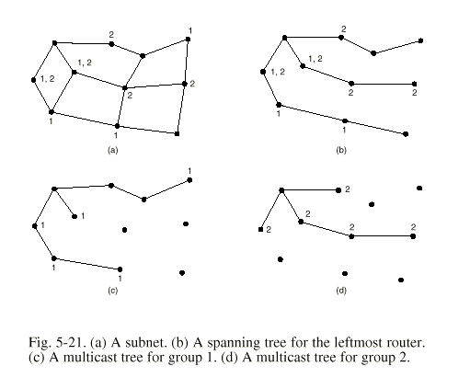
Spanning Trees for Multicast Routing

Slide 80
Multicast Routing (continued)
With Link State Routing the routers are aware of network topology and the spanning tree can be computed
With Distance Vector Routing reverse path forwarding is used.
  When a router receives a packet for a multicast group for which it has no subscribers (hosts or other routers), the router sends a PRUNE message to the source router.

Slide 81
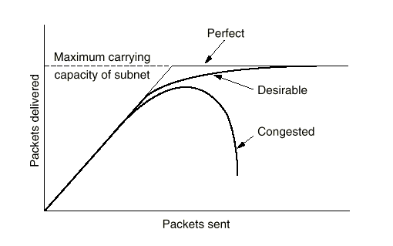
Congestion Control Algorithms
Congestion - the situation in which too many packets are present in the subnet.

Slide 82
Causes of Congestion
Congestion occurs when a router receives data faster than it can send it
  Insufficient bandwidth
  Slow hosts
  Data simultaneously arriving from multiple lines destined for the same outgoing line.
The system is not balanced
  Correcting the problem at one router will probably just move the bottleneck to another router.

Slide 83
Congestion Causes More Congestion
  Incoming messages must be placed in queues
    The queues have a finite size
      Overflowing queues will cause packets to be dropped
      Long queue delays will cause packets to be resent
      Dropped packets will cause packets to be resent
    Senders that are trying to transmit to a congested destination also become congested
      They must continually resend packets that have been dropped or that have timed-out
      They must continue to hold outgoing/unacknowledged messages in memory.

Slide 84
Congestion Control versus Flow Control
Flow control
  controls point-to-point traffic between sender and receiver
  e.g., a fast host sending to a slow host
Congestion Control
  controls the traffic throughout the network

Slide 85
Two Categories of Congestion Control
Open loop solutions
  Attempt to prevent problems rather than correct them
  Does not utilize runtime feedback from the system
Closed loop solutions
  Uses feedback (measurements of system performance) to make corrections at runtime.

Slide 86
General Principles of Closed Loop Congestion Control
Monitor the system to detect when and where congestion occurs.
Pass this information to places where action can be taken.
Adjust the system operation to correct the problem.

Slide 87
Metrics Used in Closed Loop Congestion Control
Percentage of packets discarded due to buffer overflow
Average queue length
Percentage of packets that time-out
Average packet delay
Standard deviation of packet delay

Slide 88
Reducing Congestion
Two Methods
  Increase resources
    Get additional bandwidth
      Use faster lines
      Obtain additional lines
      Utilize alternate pathways
      Utilize “spare” routers
  Decrease Traffic
    Send messages to senders telling them to slow down
    Deny service to some users
    Degrade service to some or all users
    Schedule usage to achieve better load balance

